Slide 1
Welcome To PRESENTATION

Slide 2
Name- Nirmala sahu
Class- Bsc2year
Subject- physics
Date – 02.06.2021
College-Govt.Naveen College Gurur ,Balod(CG).

Slide 3
Presentation Title –
Ideal gas.

Slide 4
Content-
Introduction
Boyle’s Law
Charle’s Law
Ideal gas equation
Van der waals Equation of state

Slide 5
Introduction

Slide 6
2. Boyle’s Law

Slide 7
3. Charlie’s law

Slide 8
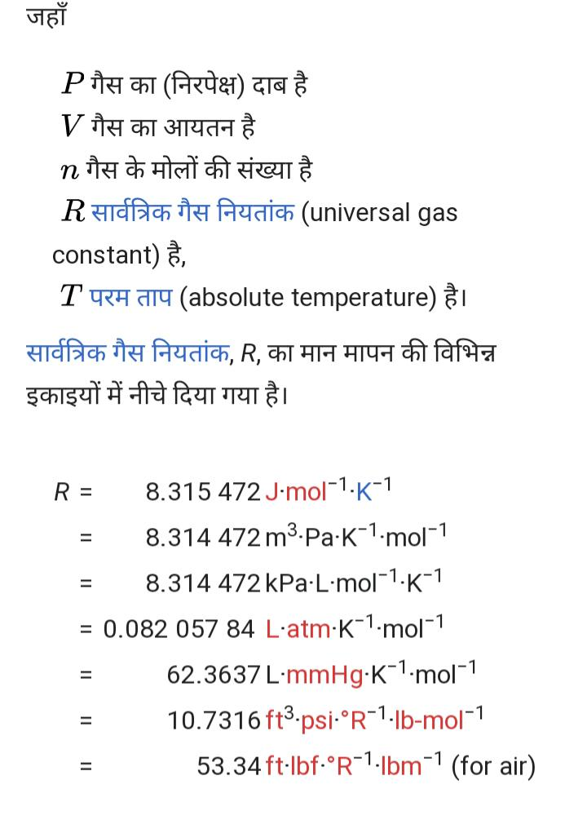
4. Ideal gas equation

Slide 9
5.Van der waals equation of state

Slide 11
Thank
YOU.

